Slide 1
VetLink Capabilities Overview
Veteran and Staff Functionality

Slide 2
What is VetLink?
For the Veteran:
Touchscreen self-service patient kiosks
Enable independent check-in, requests for VA services, and information updates
For staff:
Application to manage patient check-ins and updates, coordinate care across team(s), analyze data to inform clinic / facility management
Supports kiosk operations, and coordinates data transfer with VistA
Access to highly configurable VetLink software components that enable staff to build service and facility-specific workflows

Slide 3
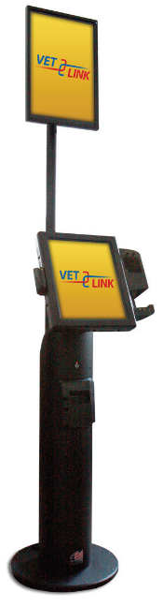
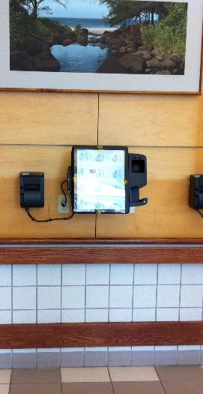
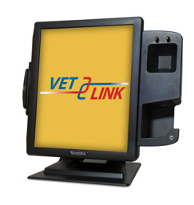
VetLink Kiosks: Three Types
Freestanding (FS)
Table Top (TT)
Wall-mounted (WM)

Slide 4
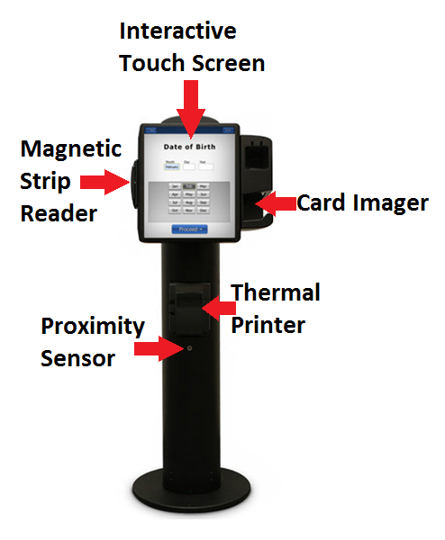
Kiosk Details
Interactive Touch Screen
Kiosk Peripherals
Magnetic Strip Reader
Barcode Scanner / Card imager
Thermal Printer
Proximity Sensor
Headphone Jack (below card imager)

Slide 5
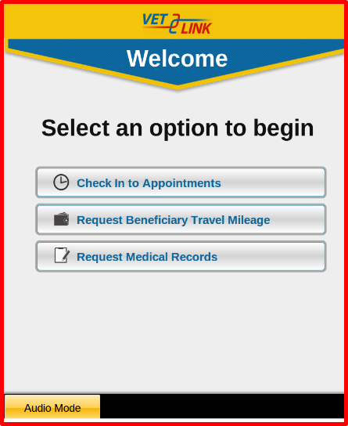
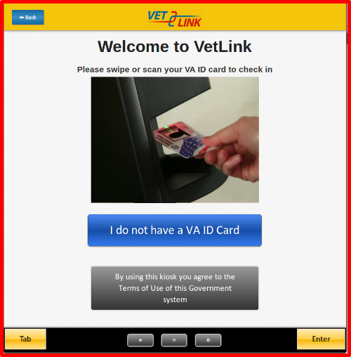
Veteran Accessibility Mode
What is accessibility mode?
Information on the kiosk will be available through headphones
Veterans can navigate using Tab and Enter buttons or by double tapping on selections
Volume and rate of speech controls are available

Slide 6
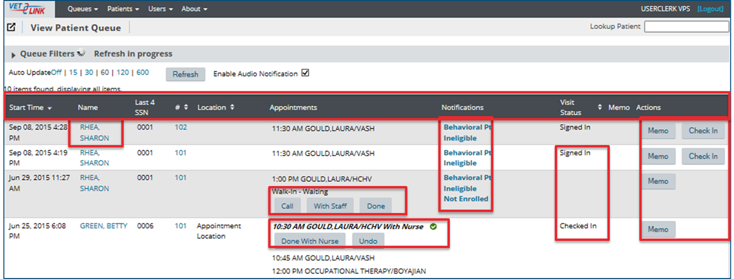
Staff-Facing Patient Queue
Real-time list of patients that can be filtered and/or sorted according a variety of criteria. Staff can use their view of the Patient Queue as an active work list of patients awaiting their attention.

Slide 7
Examples of Staff-Facing Notifications
VistA-Based
Behavioral Pt (all Cat1 PRFs)
Not Enrolled / Ineligible
Outstanding Balance
Means Test Due
Issue at Kiosk
Unreadable VHIC
Timeout
Exited
Incorrect Identity
Locked Out
Error
Beneficiary Travel Failed Printing
Veteran-Indicated
Insurance Incorrect
Insurance to be Added
Contact Info Updates Pending
Worker’s Comp/Legal
Transport Priority
Interested in MVP
Beneficiary Travel Application Submitted
Beneficiary Travel Assistance Required

Slide 8
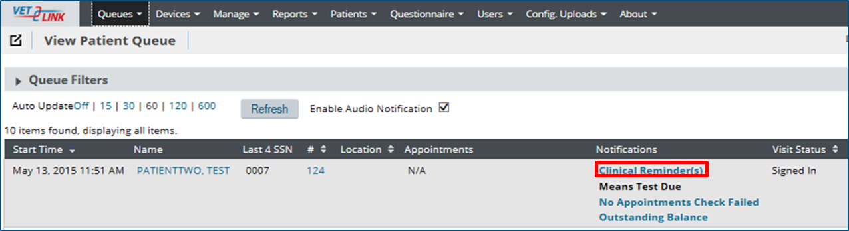
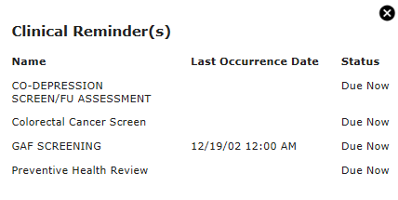
Hyperlinked Notifications Clinical Reminders Example

Slide 9
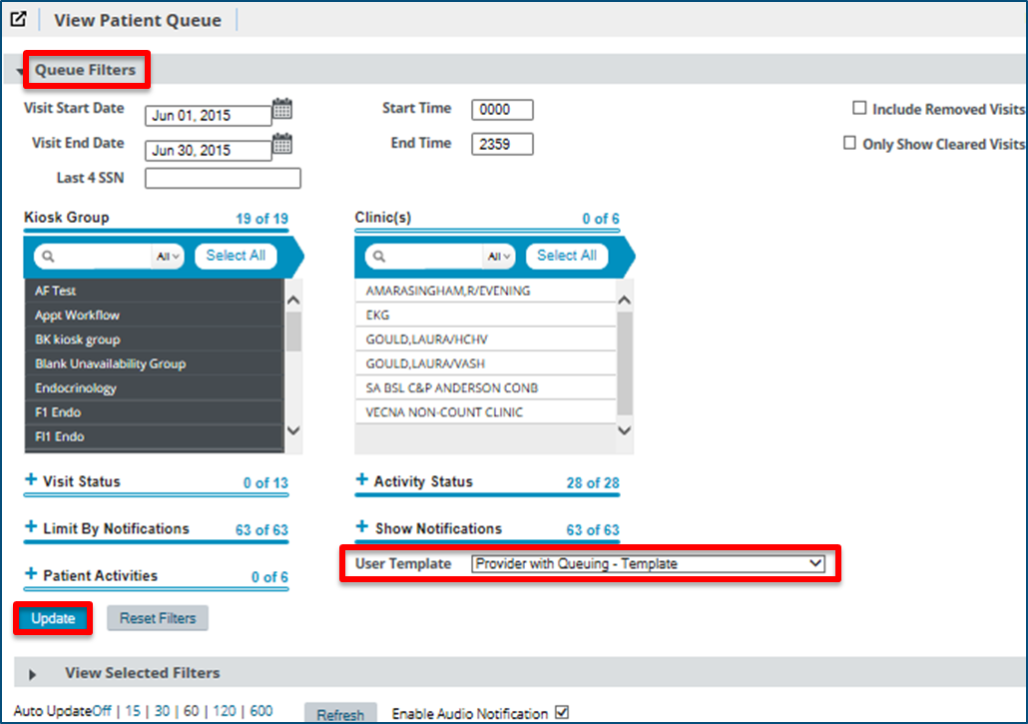
User Templates & Filters
User Templates are preset combinations of filter options (e.g. Kiosk Group, Activity Status, Clinic). They enable groups of users to filter and view patients they’re responsible for and can function as a work list.

Slide 10
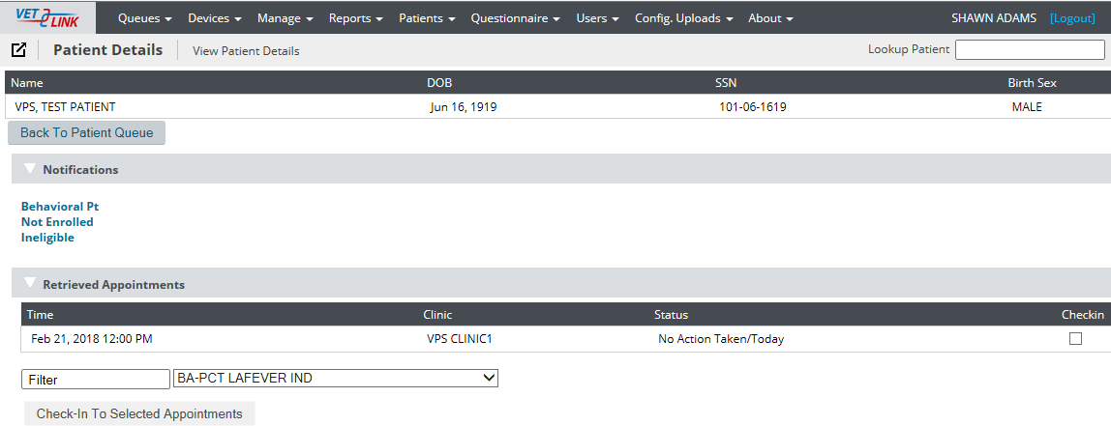
Manually Check In a Veteran
If the patient tried to check in at the kiosk:
If the patient did not use the kiosk:
Locate the patient in the Admin Patient Queue
Select CHECK-IN
Navigate to Patient > Patient Lookup or use Patient Lookup widget
Search for the patient.
Make any needed information changes.
Select SAVE CHANGES.
Select the Checkin box.
Select CHECK-IN TO SELECTED APPOINTMENTS.
Answer Verification message.

Slide 11
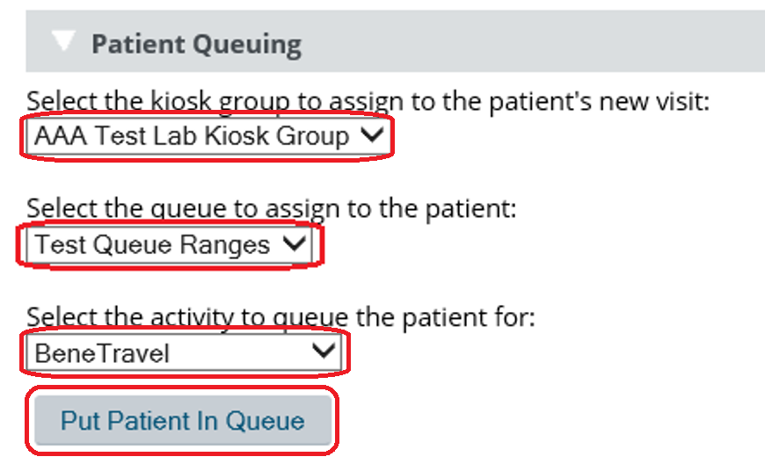
Adding Walk-In Patients to Queue in VetLink

Slide 12

Benefits of Using VetLink for Veterans
Convenience
Consistency
Kiosks empower Veterans
Check in for appointments
Update data
View/Print future appointments
View/Print directions to appointments
Request BeneTravel reimbursement
Request medical records (ROI)
Request same day services or information
Answer national / facility questionnaires

Slide 13
Benefits of VetLink for Staff
Frees staff to spend more time interacting with Veterans, examples include:
Focus on check-in exceptions
Manage urgent requests and walk-ins
Provide check-out functions
E.g. Appointment follow-up & future appointment scheduling
Enables efficient and easy communication
Formalizes initial engagement across the facility
Improves front and back office communication
Standardizes and improves patient tracking methods
Ensures accurate and up-to-date information through patients’ control of their personal data
Enforces national and local standards
Logic checks prevents patients from checking under certain conditions (e.gs. Too late and Ineligible)
Logic checks require review of information at set intervals (e.g. NOK information can be set to be reviewed every 90 days)
Can trigger automatic printing of forms (custom-made or VistA printouts)

Slide 14
VetLink Functionalities Presently Deployed
Primary Workflows
Pre-registration
Contact Info / Insurance / NOK review
Check-in
Combined (most used workflow)
Check-In + Prereg with most other offerings made available
Request Medical Records (ROI)
Request Benefit Travel (2^{nd or} 3rd most used)
Walk-In Workflows / Queuing (2nd or 3rd most used)
Appointment-Based Wayfinding
View Future Appointments
Update My Information
Patient Tracking
Check In
Surgery
Walk-Ins (PC, SC, MH, etc…)
Enrollment Office, Optical Shop, Labs, etc…
Add-ins for the workflows
MVP
View Future Appointments
Update My Information
View Balance
Appointment-Based Wayfinding
Clinical Reminders (e.g. flu shots)
Patient Queuing
Patient Questionnaires
Primary Workflows as sub-workflows
Information Display and Fact Sheet printouts

Slide 15
VetLink Functionalities Product Backlog
Presently in sustainment-only mode due to funding
Product Backlog exists for many features, both new and enhancements to existing capabilities
Some major items include:
Insurance Card Scanning (was briefly piloted)
BeneTravel System Integration
Clinical Reminder – Phase 2 (Write)
Vitals Kiosk
Wayfinding – Phase 2 (was briefly piloted)
Release of Information – Phase 3 (Additional ROI forms, esignature, and/or digital signature)
MHV Integration
Complete Backlog is available online
https://vavps.aha.io/published/a1a4b62c5cd509b13f2a7c770387fc48?page=2

Slide 16
VetLink Statistics Appointments
VetLink Impact on Check-In
75%+ (3m+) of appointments checked in by VetLink per month
30-35%+ by Patients using VetLink Kiosks
40-45% by Staff using VetLink Staff Application

Slide 17
VetLink Statistics Queuing
Queuing
In use at 97 sites
56 – Walk-In workflow
55 – Appointment workflow
24 – Both Walk-In and Appointment Workflow
~150k walk-ins per month (e.gs. Lab, Radiology, Enrollment, Optical Shop)
~270k appointment-based queuing per month

Slide 18
VetLink Statistics Demographic Updates
90k Updates Submitted by Patients per month
Individual Data Elements Breakdown
Update Category | Average Updates per Month
Address | 12.5k
Phone | 65k
Email | 34k
NOK1 | 95k
NOK2 | 4.5k
ECONT1 | 74.5k
ECONT2 | 3k
Race | 10k
Ethnicity | 3.5k

Slide 19
VetLink Statistics Beneficiary Travel
330k Unique Patients using VetLink BeneTravel per month
575k VetLink BeneTravel submissions per month

Slide 20
Staff Coordination: Activity Buttons
Clinical | Administrative | Laboratory | Pharmacy | Radiology
Call | Call | Call | Call | Call
Call Again | Call Again | Call Again | Call Again | Call Again
Undo | Undo | Undo | Undo | Undo
No Show | Not Seen | No Show | Not Seen | Not Seen
With Clerk | With Staff | With Lab Clerk | With Tech | With Staff
Done with Clerk | Done With Staff | Done With Lab Clerk | Done With Tech | Done With Staff
With Nurse | Done | With Lab Tech | With Pharmacist | With Tech
Done With Nurse |  | Done With Lab Tech | Done With Pharmacist | Done With Tech
With Provider |  | Done With Lab Order |  | With Radiologist
Done With Provider |  |  |  | Done With Radiologist
Done With Appointment

Slide 21
Example Functionality Overviews
Queuing
Questionnaires
Flu Screening
Beneficiary Travel
Patient Tracking
Surgery
Release of Information
Million Veteran Program

Slide 22
Functionality: Queuing
Two types:
Stand-Alone/Walk-In Queuing
With Authentication
Without Authentication
Appointment-Based Queuing
Offers staff easy way to manage patient flow in clinic areas:
Patient can receive a queue number at kiosk
Staff calls patient to window using Action Buttons on the Patient Queue
Waiting room can have a Patient-Facing Queuing Display to show the numbers or patients presently called by staff and where to report to
Automated voice can also call out the patient number being called and which station/window to report to
Data can be analyzed to better understand bottlenecks, and assess progress, and understand the amount of services being provided

Slide 23
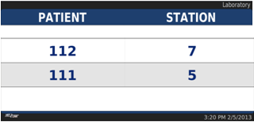

Queuing: Patient-Facing System
Patient-Facing Queuing Displays
Visible to Veterans
Displays the number of the Patient being called
Displays the Station number or window where the Veteran will be assisted
Staff-Facing
Displays
Visible to the clinic staff
Configurable display options
Can display the number of Veterans currently waiting in the queue
Can show list of waiting patients, activity status, clinic and location

Slide 24
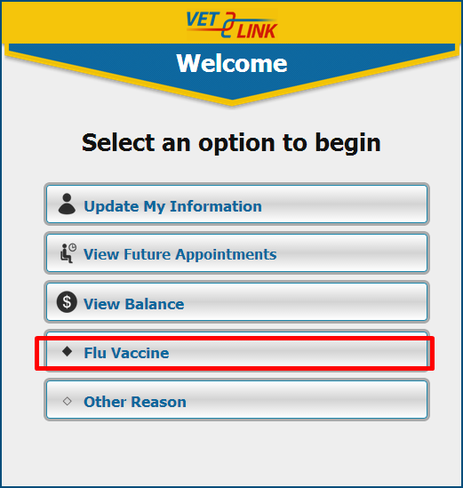
Patient Questionnaires
Questionnaires can display as their own workflow option (i.e. Main Menu) or embedded within certain workflows
Customized to the location
Multiple question types
Logic-based (e.g. Go to Question 3 if Question 1 is answered with X)
Actions can be set based on certain conditions (e.g. Add to Patient Activity “Optical Shop” if option 2 is selected on question 1)
Questionnaires are the basis for creating Walk-in Service options (e.g. “Walk-in Audiology”)
Can be written to VistA for recall within a TIU note via PDO invocation

Slide 25
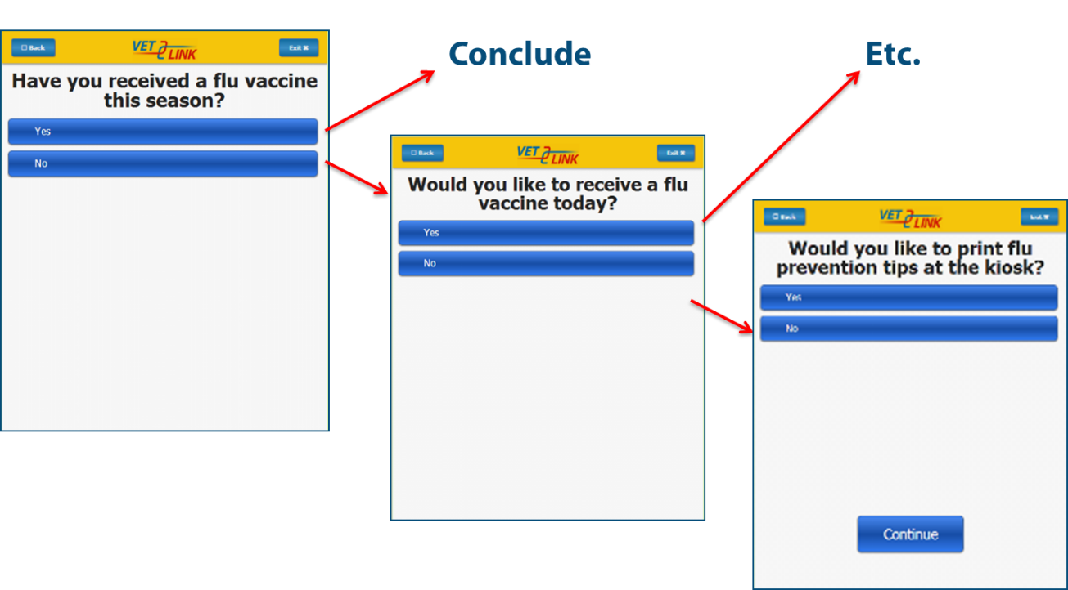
Additional Questions Display as Veteran Responds to Questions

Slide 26
Question Types
Descriptive / Informative
No response option offered; used to indicate information such as “Please have a seat to your left”
Multiple Choice (most used)
Radio button or multiselect
Default option can be selected
Can be required before proceeding
Hidden values can be assigned to response options
Date
Presents a calendar
Can be constrained to past dates or future dates
Question / Questionnaire Item Group
Used in conjunction with hidden values for calculated values (e.g. PHQ-9)

Slide 27
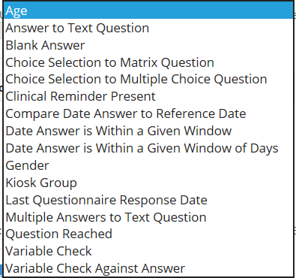
Questionnaire Logic
Can be set as “IS” or “IS NOT” statements
Multiple settings contained within each logic option
E.g. Choice Selection to Multiple Choice Question <question number> is <response option> for <last/any/all> responses
Can be combined with other logic
AND / AND NOT / OR / OR NOT

Slide 28
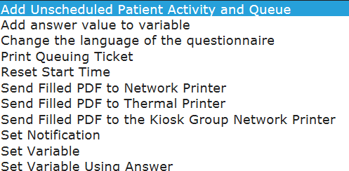
Questionnaire Actions
Multiple actions sets can be created
i.e. Do X for these instances and do Y for these other instances
Multiple actions can be done within a single action set
i.e. Do X and Y for Action Set 1

Slide 29
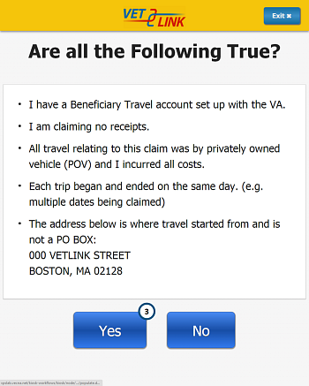
Beneficiary Travel
VetLink Request Beneficiary Travel Mileage Reimbursement allows Veterans to use a kiosk to provide information about their mileage reimbursement claim and agree to conditions for reimbursement.

Slide 30
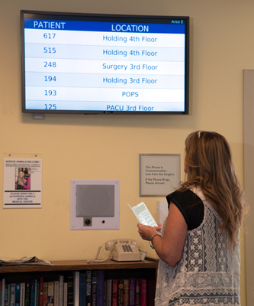
Patient Tracking Surgery
Surgery Patient Tracking enables VA staff and providers to easily update the status of patients in surgery
Improves cross-team communication
Chaplain Service
Inpatient Wards
Within the Surgery team
Holding
Surgery Suite
Recovery unit (PACU)
Front Desk
Multi-floor surgery units
Allows patients’ family and friends to track them through the surgery process
Reduces interruptions of staff

Slide 31
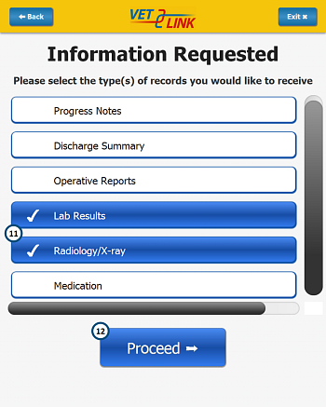
Release of Information
Veterans may request a copy of their medical records from the kiosk
The Veteran initiates the request at the kiosk
Options permit the patient to indicate they want to pick up the copy or have it mailed

Slide 32
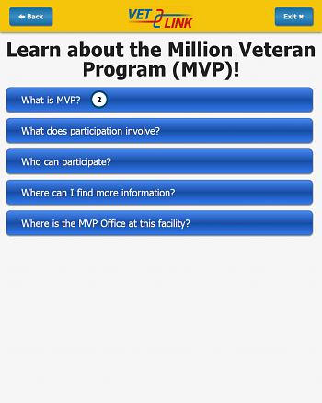
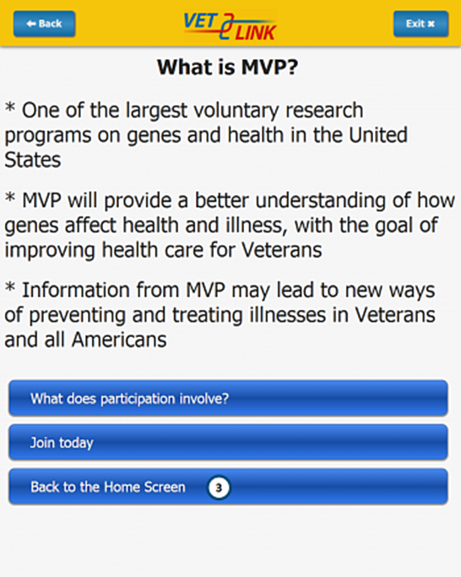
Million Veteran Program (MVP)
Introduces MVP program and its purpose so Veterans may learn more about or join the program
Partnering with Veterans allows the MVP program to build one of the world’s largest medical databases by safely collecting blood samples and health information from one million Veteran volunteers

Slide 33
Q&A
VA Pulse page (https://www.vapulse.net/groups/vetlink)
https://www.vapulse.net/groups/vetlink/blog/2015/09/02/initial-sharing-of-information
Training website
TMS Links
POCS
Vendor Support
Site Leads
PMO
Community Email Group
Request Hardware
Open Office Hours information

